Slide 1
Discrete Mathematics Basic Structures & Boolean Algebra
by Akkradach W.
Dept. of Computer Engineering
KMITL

Slide 2
Agenda
Chapter 2
Sets
Set Operations
Functions
Sequences and Summations
Chapter 11
Boolean Functions
Representing Boolean Functions

Slide 3
#2 Basic Structures Sets (1)
A set is an unordered collection of objects (naive set theory)
Universal set (U) and Empty set ({ } or ∅)
Set builder notation : Q⁺ = {x ∈ R | x = p/q; for some positive integers p and q}
N, Z, Z⁺, Q, R
A = B if and only if ∀x(x ∈ A ↔ x ∈ B)
A ⊆ B if and only if ∀x(x ∈ A → x ∈ B)
A ⊂ B if ∀x(x ∈ A → x ∈ B) ∧ ∃x(x ∈ B ∧ x ∉ A)

Slide 4
Sets (2)
Let S be a set. The cardinality of S is |S|
P(S) is the set of all subsets of S
Cartesian products (A × B)
Ordered n-tuple (a₁,a₂,…,a_{n}) is the ordered collection
2-tuples are called ordered pairs
A × B = {(a,b) | a ∈ A ∧ b ∈ B}
Subset R of A × B is called a relation from A to B

Slide 5
Sets (3)
Quanlifiers
∀x∈R(x² ≥ 0)
∃x∈Z(x² = 1)
Quanlifiers and Truth Sets
P(x) is “|x| = 1”
{x ∈ Z ||x| = 1} = {-1, 1}
Q(x) is “x² = 2”
{x ∈ Z | x² = 2} = ∅
R(x) is “|x| = x”
{x ∈ Z ||x| = x} = Z⁺

Slide 6
#2 Basic Structures Set Operations (1)
Intersection : A ∩ B
A and B are called disjoint if A ∩ B = ∅
Union : A ∪ B
|A ∪ B| = |A|+|B|-|A ∩ B|
Difference : A – B = {x | x∈A ∧ x∉B}
Complement : Ā = U – A

Slide 7
Set Operations (2)
Set Identities
Identity laws
Domination laws
Idempotent laws
Complementation law
Commutative laws
Associative laws
Distributive laws
De Morgan’s laws
Absorption laws
Complement laws
Table 1, Page 124

Slide 8
Generalized ∪ and ∩

Slide 9
#2 Basic Structures Functions (1)
Let A and B are non-empty sets, if ƒ is a function (mapping or transformation) from A (domain of ƒ) to B (co-domain of ƒ), we write
ƒ : A → B
If ƒ(a) = b
b is the image of a
a is the pre-image of b
Range of ƒ is the set of all images of elements of A

Slide 10
Functions (2)
Let ƒ₁ and ƒ₂ are functions from A to R,
(ƒ₁ + ƒ₂)(x) = ƒ₁(x)+ ƒ₂(x)
(ƒ₁ ƒ₂)(x) = ƒ₁(x) ƒ₂(x)
One-to-One (injective)
∀a∀b(ƒ(a) = ƒ(b) → a = b)
∀a∀b(a ≠ b → ƒ(a) ≠ ƒ(b))
Onto (surjective)
∀b∃a(ƒ(a) = b)
One-to-One Correspondence (bijection)

Slide 11
Functions (3)
Let ƒ is a one-to-one correspondence from A to B, the inverse of function ƒ is ƒ⁻¹
ƒ⁻¹(b) = a when ƒ(a) = b
Let g is a function from A to B and f is a function from B to C, the composition of function f and g is f ◦ g
(f ◦ g)(a) = f(g(a))

Slide 12
Functions (4)
Graph of ƒ is the set of ordered pairs
{(a,b) | a ∈ A and ƒ(a) = b}
⎣x⎦ Floor function : largest int ≤ x
⎡x⎤ Ceiling function : smallest int ≥ x

Slide 13
#2 Basic Structures Sequences
A sequence is a function from {0, 1, 2, …} or {1, 2, 3, …} to S
Geometric progression
a, ar, ar², …, ar^{n}, … ; a and r ∈ R
Arithmetic progression
a, a+d, a+2d, …, a+nd, … ; a and d ∈ R
Some useful sequences
n² (or n^{k})
2^{n} (or k^{n})
n!

Slide 14
Summations (1)

Slide 15
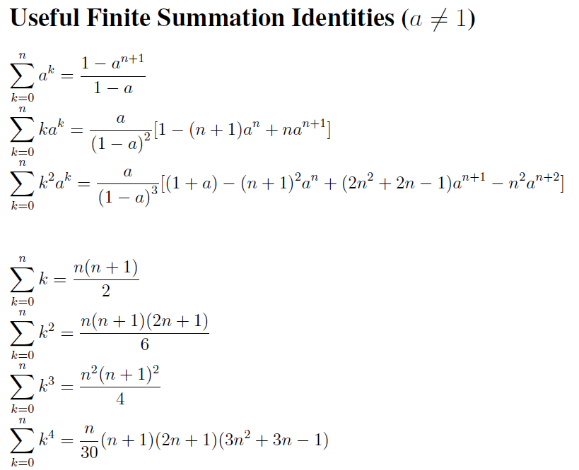
Summations (2)

Slide 16
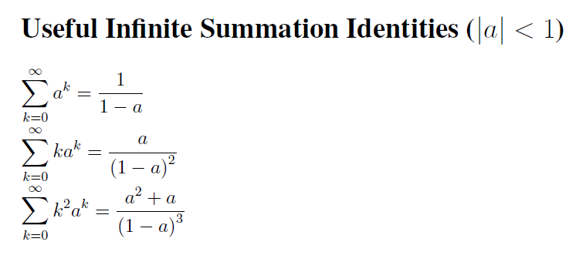
Summations (3)

Slide 17
#11 Boolean Algebra
History
1854 George Boole (Basic Operations)
1938 Claude Shannon (Information Theory)
Boolean Functions
Representing Boolean Functions
Logic Gates*
Minimization of Circuits*

Slide 18
Boolean Functions (1)
Boolean Algebra : {0, 1}
Propositional Logic : {False, True}
Complement / OR / AND operations
Boolean function of Degree n
Let B = {0,1}
B^{n} = {(x₁,x₂,…,x_{n})| x_{i} ∈ B for 1 ≤ i ≤ n}

Slide 19
Boolean Functions (2)
Boolean expressions (Recursive Def.)
0, 1, x₁,x₂,…,x_{n} are Boolean expressions
If E₁ and E₂ are Boolean expressions, then Ē₁, (E₁E₂), and (E₁+E₂) are
Function equivalence
Boolean functions F and G of n variables are equal if and only if F(b₁,b₂,…,b_{n}) = G(b₁,b₂,…,b_{n}) whenever b₁,b₂,…,b_{n} belong to B

Slide 20
Boolean Functions (3)
Boolean sum
(F+G)(x₁,x₂,…,x_{n}) = F(x₁,x₂,…,x_{n})+G(x₁,x₂,…,x_{n})
Boolean product
(FG)(x₁,x₂,…,x_{n}) = F(x₁,x₂,…,x_{n})G(x₁,x₂,…,x_{n})

Slide 21
Boolean Functions (4)
Boolean Identities
Law of the double Complement
Idempotent laws
Identity laws
Domination laws
Commutative laws
Associative laws
Distributive laws
De Morgan’s laws
Absorption laws
Unit property
Zero property
Table 5, Page 753

Slide 22
Boolean Algebra
A Boolean algebra is a set B with two binary operations (∧ and ∨), elements 0 and 1, and a unary operation (ˉ) such that these properties hold for all x, y, and z in B:
Identity laws
Complement laws
Associative laws
Commutative laws
Distributive laws

Slide 23
Representing Boolean Functions
Given F() then find Expr …
Sum-of-Products (disjunctive normal form)
Product-of-Sums (conjunctive normal form)
Functional Completeness (minterm, NAND, NOR)

